Slide 1

Out-of-Sample Return Predictability: A Quantile Combination Approach
Presented by
Harshvardhan
Yu Jiang
Business Analytics and Statistics,
Haslam College of Business,
University of Tennessee
Luiz Lima and Fanning Meng
Journal of Applied Econometrics

Slide 2
Table of Content
Introduction
Notions and Definitions
Methodology
Estimator
L1 penalized quantile regression
Alternative Interpretation
Weight Selection
Data and Evaluation
Results
Why PLQC Forecast over FQC?
Variables Selected
Robustness Analysis
Conclusion

Slide 3
Introduction
Forecasting stock returns with macroeconomic predictors and valuation ratios is inaccurate due to presence of weak predictors
Conditional mean forecasts use all predictors while quantile forecasts (FQC) use only strong predictors
Lima and Meng (2016) propose Lasso based regularization forecasting model for identifying weak and partially weak predictors called PLQC
PLQC outperforms most benchmark models over the time period 1967 and 2013 as found in the empirical study
Effect is more pronounced in the presence of partially weak predictors which FQC cannot handle

Slide 4
Three Steps of PLQC Forecasting
Step 1
Select statistically significant predictors using quantile regression with L1 regularization, Lasso
Step 2
Rebuild quantile forecasting model with selected predictors to estimate post-penalized regression models at different quantiles, $τ$
Rebuild quantile forecasting model with selected predictors to estimate post-penalized regression models at different quantiles, 𝜏
Step 3
Combine quantile regression point forecasts to obtain PLQC point estimate

Slide 5
Notions and Definitions
HA model: Historical Average Model
LASSO: Least Absolute Shrinkage and Selection Operator
PLQC: Post-LASSO Quantile Combination
MSPE: Mean Square Prediction Error
DGP: Data-generating Process
Fully weak predictors: A given predictor is useful to forecast no quantiles.
Partially weak predictors: A given predictor is useful to forecast some, but not all, quantiles of the equity premium
Strong predictors: A given predictor is useful to forecast all quantiles

Slide 6
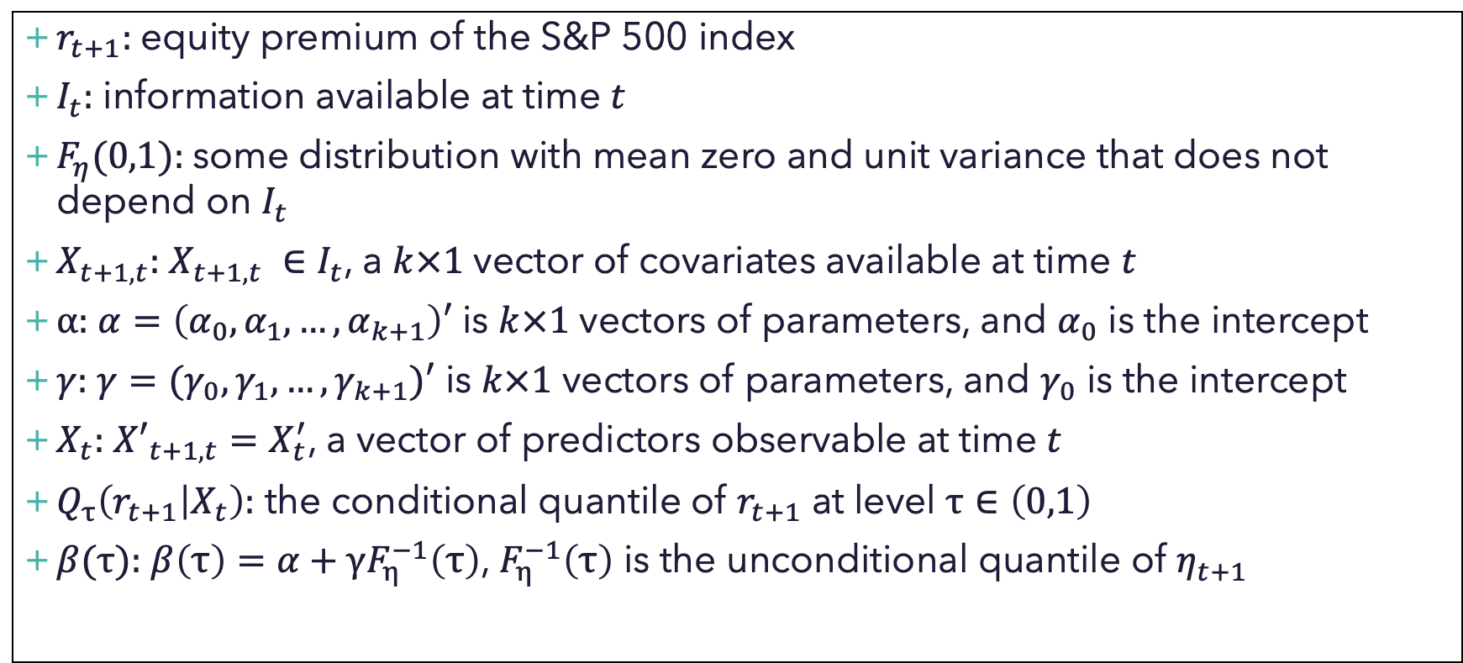
Notions and Definitions
$r_{t+1}:$equity premium of the S&P 500 index
$I_{t}:$ information available at time $t$
$F_{η}(0,1):$some distribution with mean zero and unit variance that does not depend on $I_{t}$
$X_{t+1, t}:$ $X_{t+1,t} ∈I_{t}$, a $k×1$ vector of covariates available at time $t$
$α:$ $α=\left(α_{0},α_{1},…, α_{k+1}\right)′$ is $k×1$ vectors of parameters, and $α_{0}$ is the intercept
$γ:$ $γ=(γ_{0},γ_{1},…,γ_{k+1})′$ is $k×1$ vectors of parameters, and $γ_{0}$ is the intercept
$X_{t}:$ ${X′}_{t+1,t}=X_{t}^{′}$, a vector of predictors observable at time $t$
$Q_{τ}\left(r_{t+1} | X_{t}\right):$ the conditional quantile of $r_{t+1}$ at level $τ∈\left(0,1\right)$
$β(τ):$ $β\left(τ\right)=α+γF_{η}^{−1}\left(τ\right)$, $F_{η}^{−1}\left(τ\right)$ is the unconditional quantile of $η_{t+1}$

Slide 7
Methodology

Slide 8
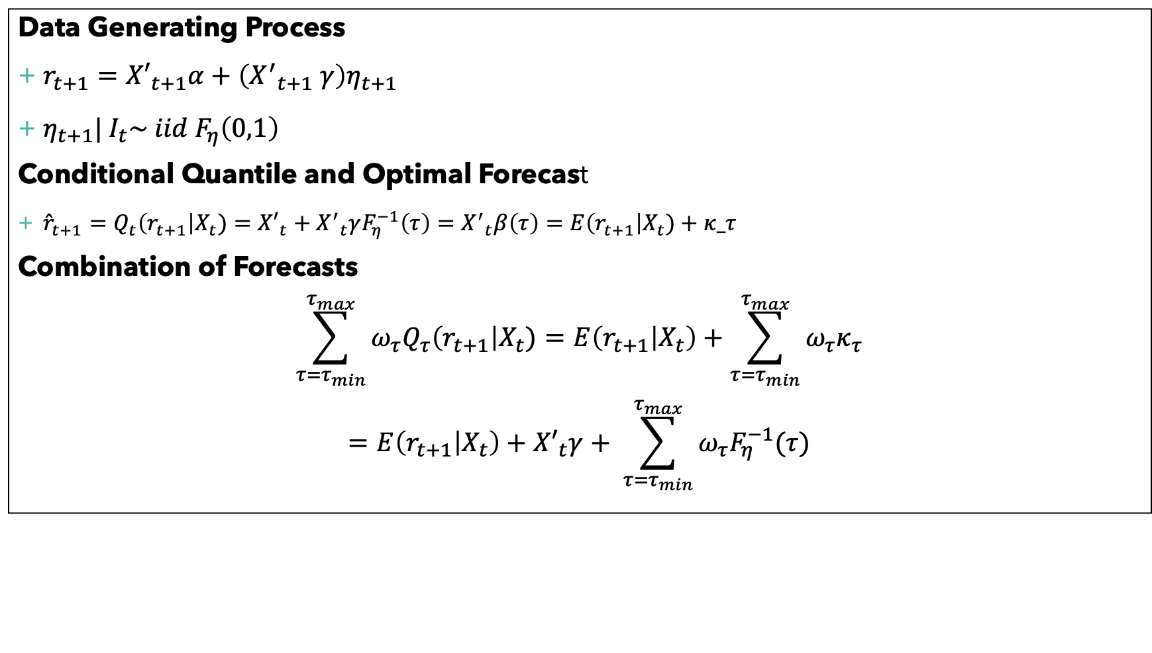
Estimator
Data Generating Process
$r_{t+1}={X′}_{t+1}α+\left({X^{′}}_{t+1} γ\right)η_{t+1}$
$η_{t+1}| I_{t}\sim iid F_{η}\left(0,1\right)$
Conditional Quantile and Optimal Forecast
${\hat{r}}_{t+1}=Q_{t}\left(r_{t+1}\right|X_{t})={X′}_{t}+{X^{′}}_{t}γF_{η}^{−1}\left(τ\right)={X^{′}}_{t}β\left(τ\right)=E\left(r_{t+1}\right|X_{t})+κ_τ$
Combination of Forecasts
$$\sum_{τ=τ_{min}}^{τ_{max}}{ω_{τ}Q_{τ}\left(r_{t+1}\right|X_{t})=E\left(r_{t+1} | X_{t}\right)+\sum_{τ=τ_{min}}^{τ_{max}}{ω_{τ}κ_{τ}}}$$
$$=E\left(r_{t+1} | X_{t}\right)+{X′}_{t}γ+ \sum_{τ=τ_{min}}^{τ_{max}}{ω_{τ}F_{η}^{−1}(τ)}$$

Slide 9
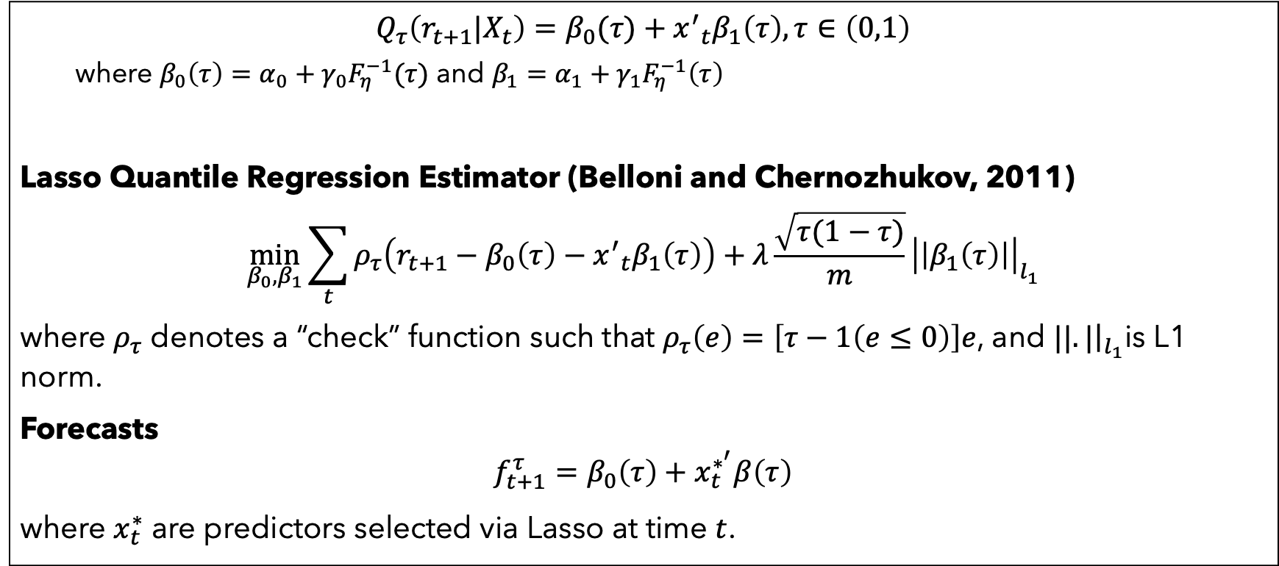
L1 Penalized Quantile Regression
$$Q_{τ}\left(r_{t+1}|X_{t}\right)=β_{0}(τ)+{x^{′}}_{t}β_{1}\left(τ\right), τ∈\left(0,1\right)$$
where $β_{0}\left(τ\right)=α_{0}+γ_{0}F_{η}^{−1}(τ)$ and $β_{1}=α_{1}+γ_{1}F_{η}^{−1}\left(τ\right)$
Lasso Quantile Regression Estimator (Belloni and Chernozhukov, 2011)
$$\min_{β_{0},β_{1}}{\sum_{t}{ρ_{τ}\left(r_{t+1}−β_{0}\left(τ\right)−{x^{′}}_{t}β_{1}\left(τ\right)\right)+λ\frac{\sqrt{τ(1−τ)}}{m}{\left|\left|β_{1}\left(τ\right)\right|\right|}_{l_{1}}}}$$
where $ρ_{τ}$ denotes a “check” function such that $ρ_{τ}\left(e\right)=\left[τ−1\left(e≤0\right)\right]e$, and $||.|{\left.​\right|}_{l_{1}}$is L1 norm.
Forecasts
$$f_{t+1}^{τ}=β_{0}\left(τ\right)+x_{t}^{∗^{′}}β\left(τ\right)$$
where $x_{t}^{∗}$ are predictors selected via Lasso at time $t$.

Slide 10
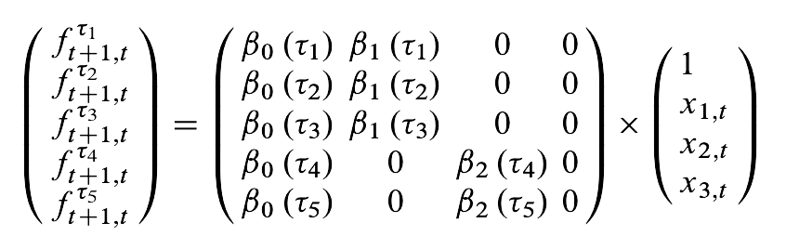
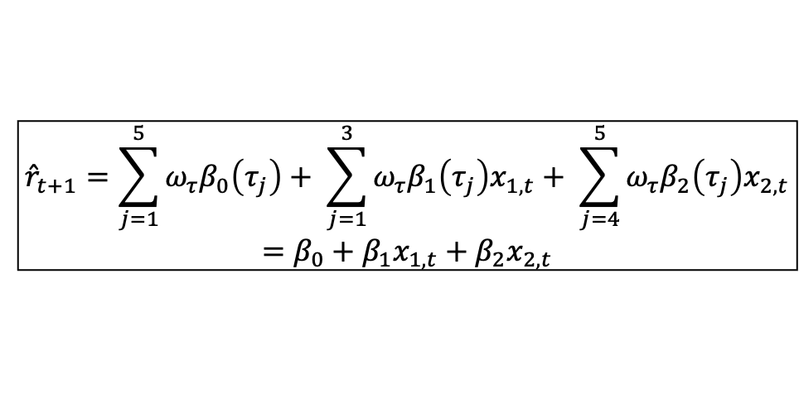
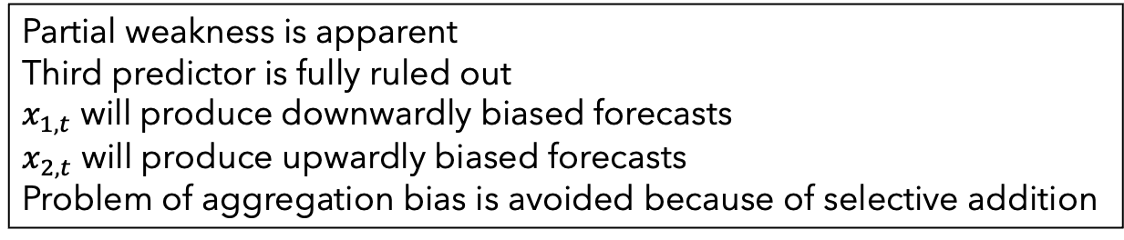
Alternative Interpretation
$${\hat{r}}_{t+1}=\sum_{j=1}^{5}{ω_{τ}β_{0}\left(τ_{j}\right)+ \sum_{j=1}^{3}{ω_{τ}β_{1}\left(τ_{j}\right)x_{1, t}+ \sum_{j=4}^{5}{ω_{τ}β_{2}\left(τ_{j}\right)x_{2, t}}}}$$
$$=β_{0}+β_{1}x_{1,t}+β_{2}x_{2,t}$$
Partial weakness is apparent
Third predictor is fully ruled out
$x_{1,t}$ will produce downwardly biased forecasts
$x_{2,t}$ will produce upwardly biased forecasts
Problem of aggregation bias is avoided because of selective addition

Slide 11
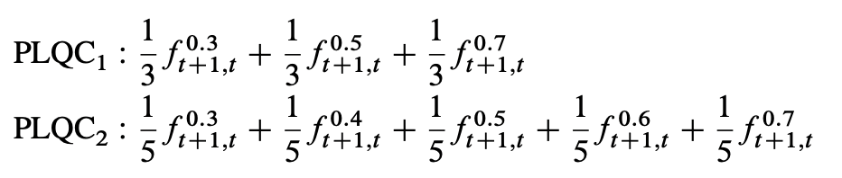
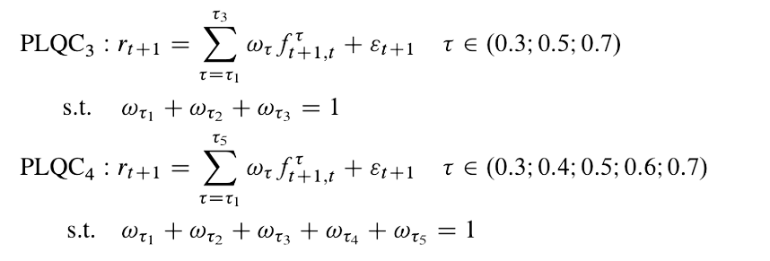
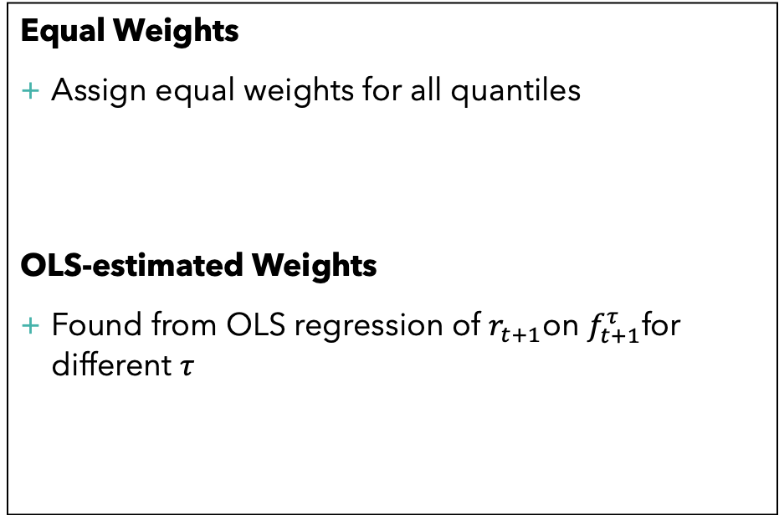
Weights
Equal Weights
Assign equal weights for all quantiles
OLS-estimated Weights
Found from OLS regression of $r_{t+1}$on $f_{t+1}^{τ}$for different $τ$

Slide 12
Empirical Results

Slide 13
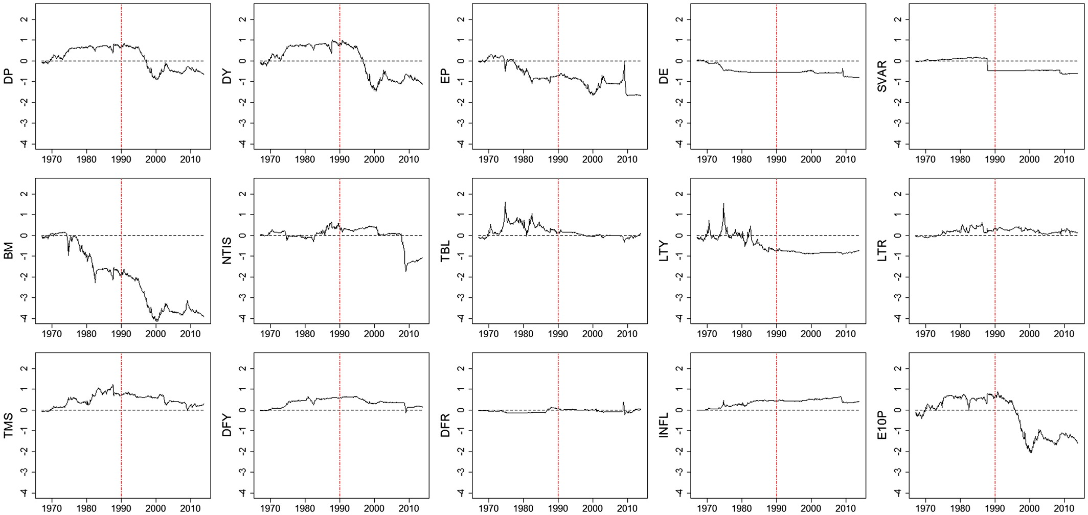
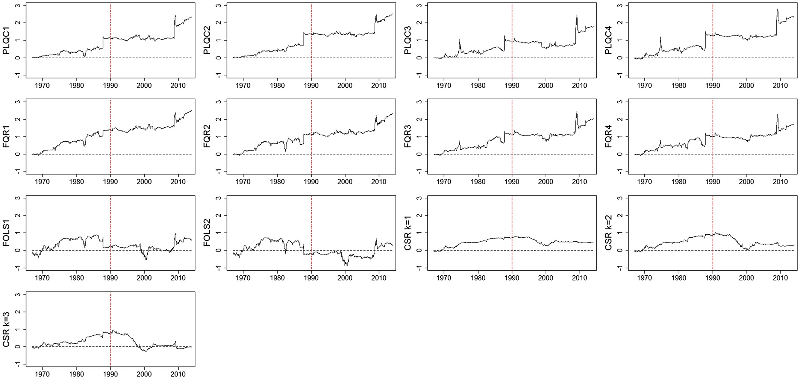
Model performance compared with benchmark models
Benchmark models perform better than single-predictor models
PLQC Model performs great, especially after 1990
Model performance is judged as cumulative squared prediction error for the benchmark model minus cumulative squared prediction errors. Positive slope indicates that conditional model outperforms the historical average and vice-versa.

Slide 14
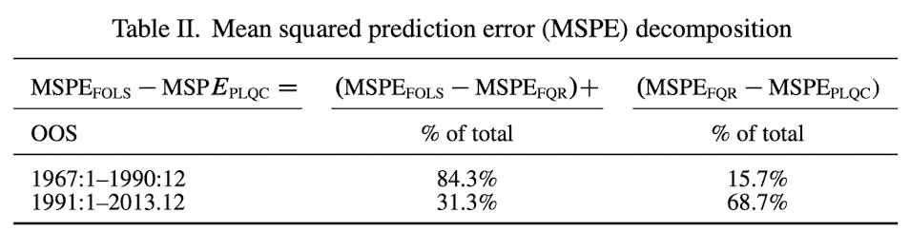
Quantile forecasting generates robust forecasts
Strong and Weak Predictors
Between 1967 and 1990, the single predictor model performs well
When predictors are strong, we don’t need models that are robust to (partially) weak predictors, except for the predictive advantage
Between 1990 and 2013, there were more weak predictors, and PLQC performs best
Error Decomposition
Quantile regression avoids the effects of estimation errors and aggregation bias

Slide 15
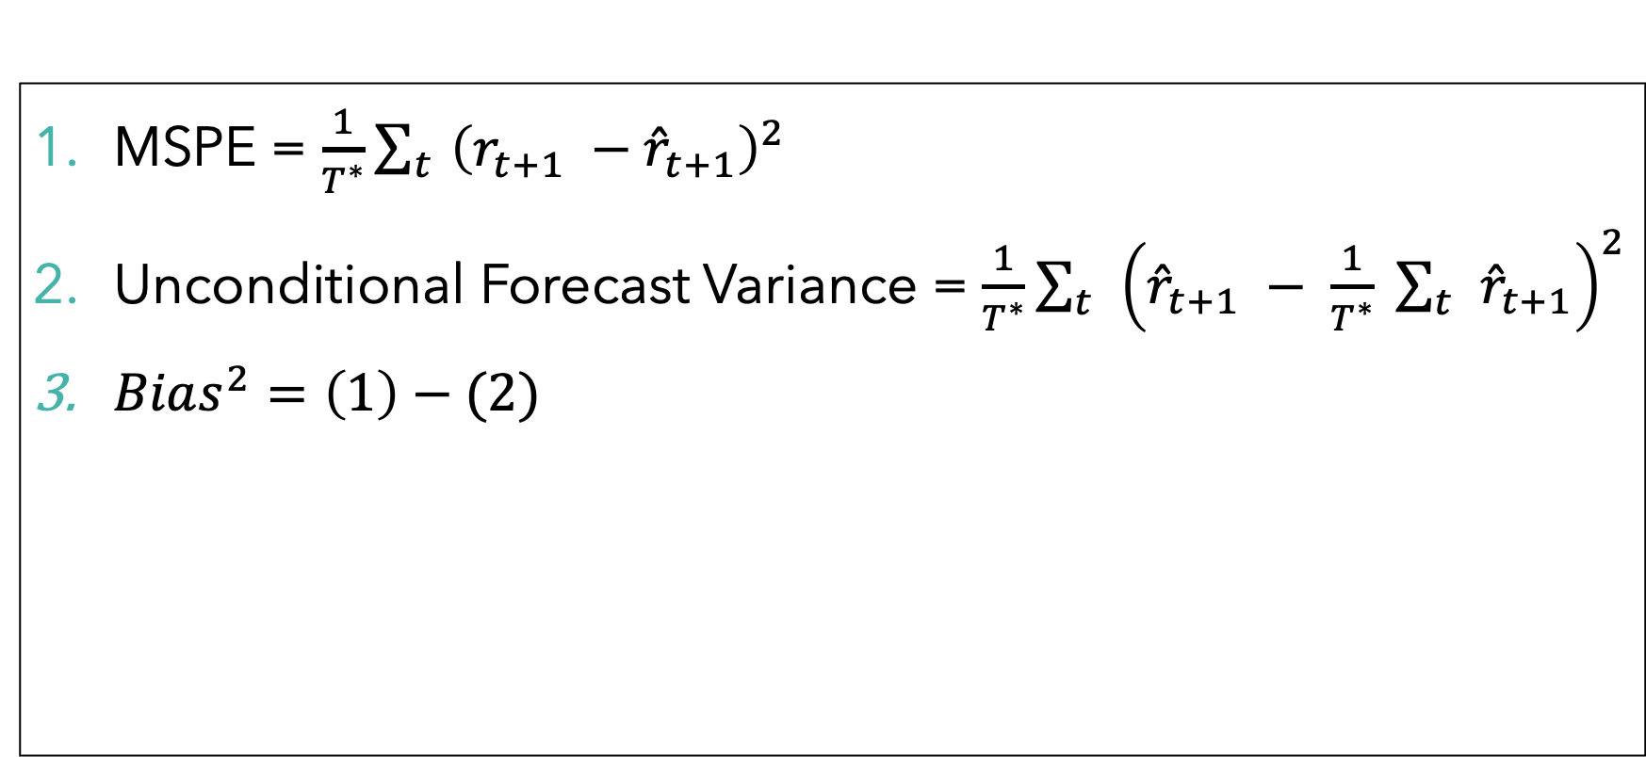
Bias-variance Decomposition of Error
MSPE = $\frac{1}{T^{∗}}\sum_{t}{{\left(r_{t+1} −{\hat{r}}_{t+1}\right)}^{2}}$
Unconditional Forecast Variance = $\frac{1}{T^{∗}}\sum_{t}{{\left({\hat{r}}_{t+1} − \frac{1}{T^{∗}} \sum_{t}{{\hat{r}}_{t+1}}\right)}^{2}}$
$Bias^{2}=\left(1\right)−(2)$

Slide 16
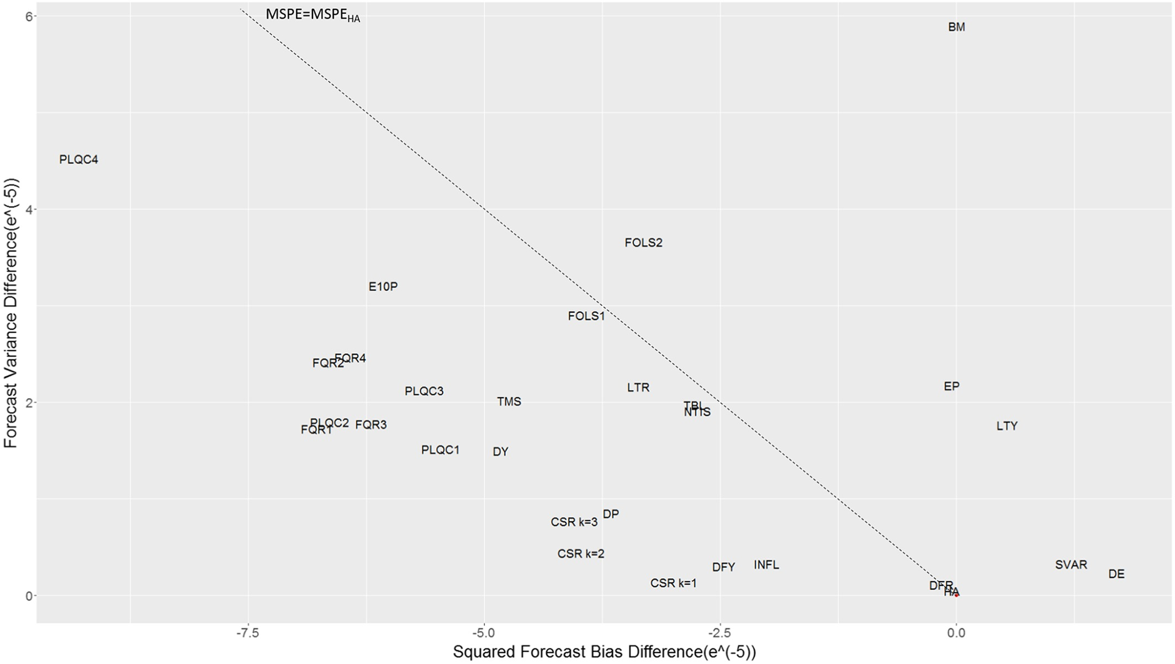
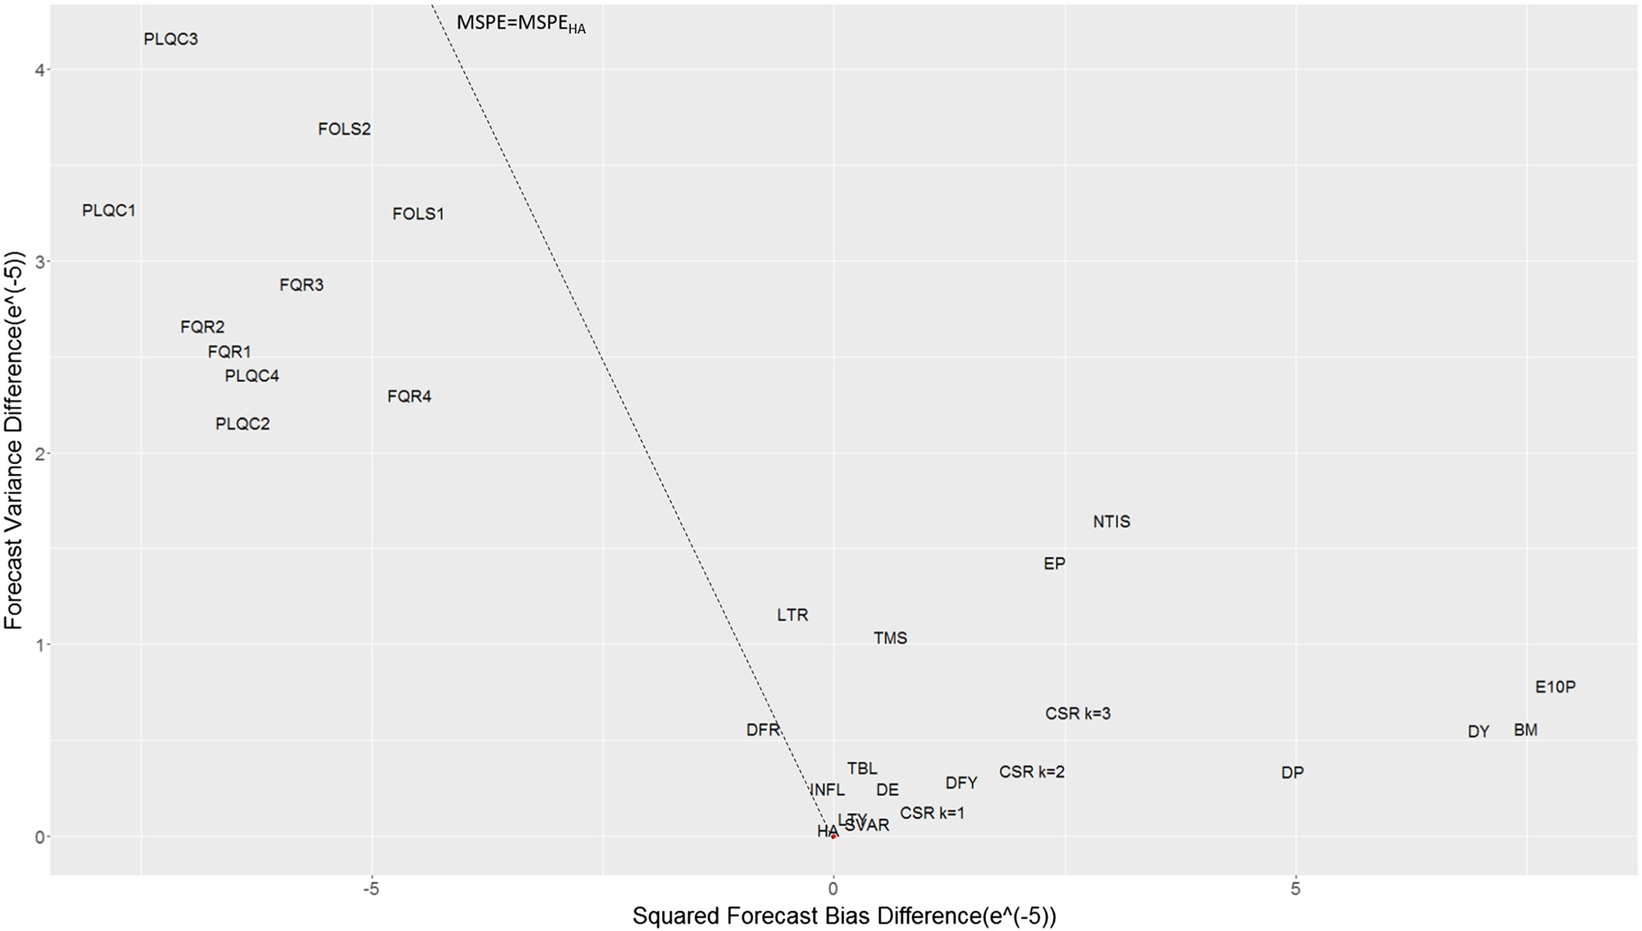
Weak predictors showcase benefits of using PLQC model
1967-90: Single-period forecasts outperform the historical average, where reduction in bias is greater than increase in variance
1991-2013: PLQC and FQR perform equally well until the noted presence of weak predictors
Each point on the dotted line represents a forecast model with the same MSPE as the historical average (HA). Models to the right are outperformed by HA, while models to left outperform HA.

Slide 17
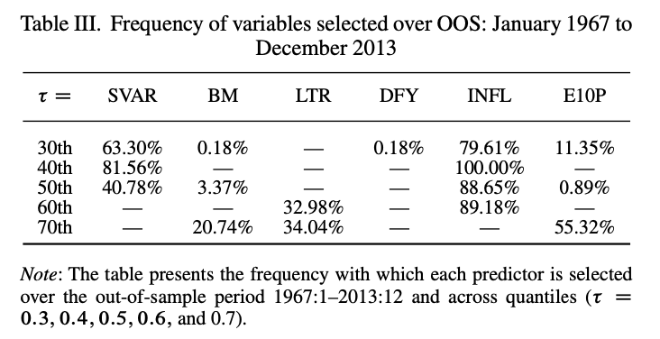
Variables selected by Lasso
There are no strong predictors, though INFL is strongest in the study
All predictors are partially weak, with DFY being useful only for predicting 0.3 quantile
SVAR is strong only in
BM and E10P are only strong in forecasting 0.3, 0.5 and 0.7 quantiles

Slide 18
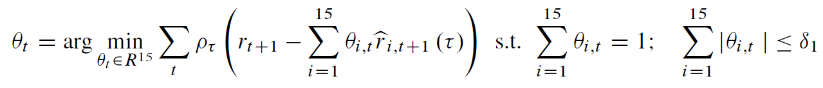
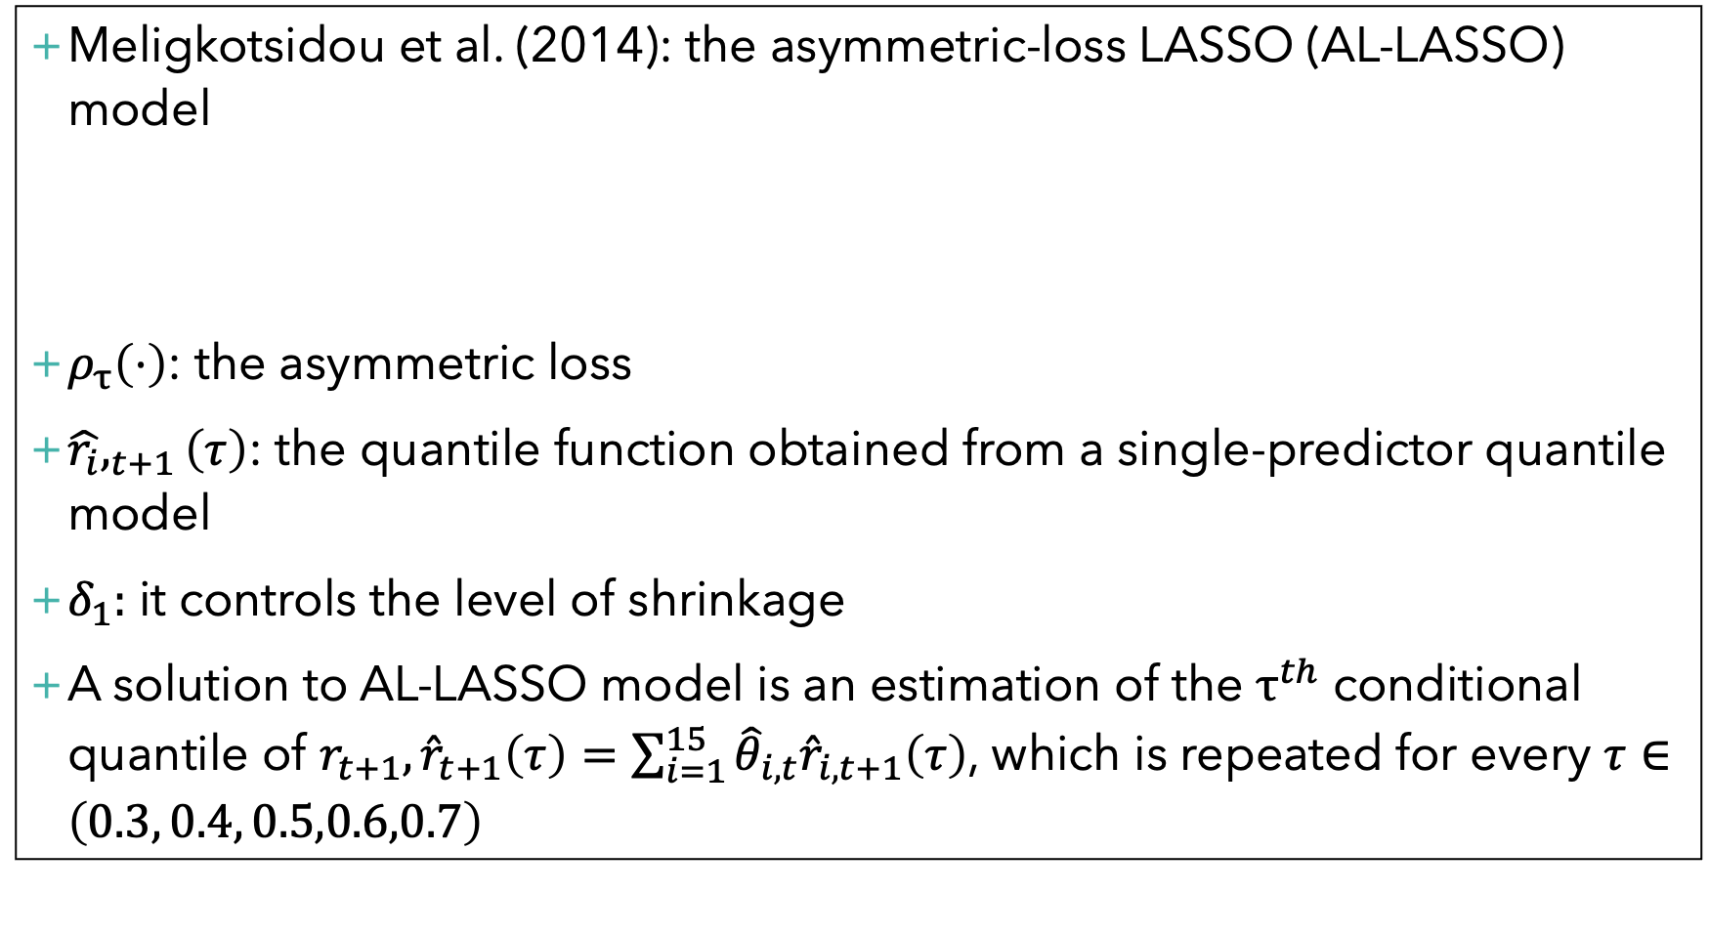
Robustness Analysis
Meligkotsidou et al. (2014): the asymmetric-loss LASSO (AL-LASSO) model
$ρ_{τ}\left(⋅\right)$: the asymmetric loss
$\hat{r_{i}},_{t+1}\left(τ\right)$: the quantile function obtained from a single-predictor quantile model
$δ_{1}:$ it controls the level of shrinkage
A solution to AL-LASSO model is an estimation of the $τ^{th}$ conditional quantile of $r_{t+1}, {\hat{r}}_{t+1}\left(τ\right)=\sum_{i=1}^{15}{{\hat{θ}}_{i,t}{\hat{r}}_{i,t+1}\left(τ\right)}$, which is repeated for every $τ∈\left(0.3, 0.4, 0.5,0.6,0.7\right)$

Slide 19
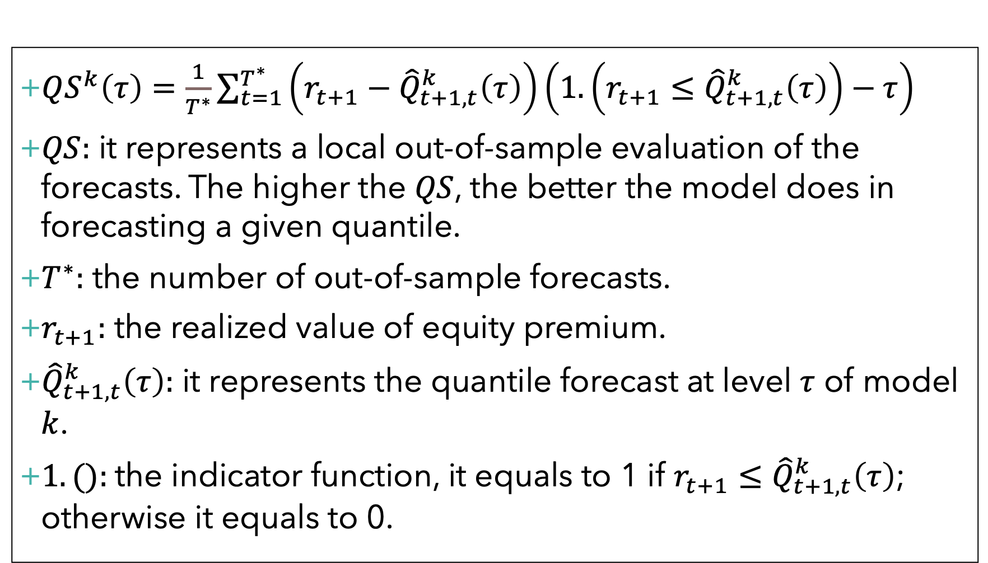
$QS^{k}\left(τ\right)=\frac{1}{T^{∗}}\sum_{t=1}^{T^{∗}}{\left(r_{t+1}−{\hat{Q}}_{t+1,t}^{k}\left(τ\right)\right)\left(1.\left(r_{t+1}≤{\hat{Q}}_{t+1,t}^{k}\left(τ\right)\right)−τ\right)}$
$QS:$ it represents a local out-of-sample evaluation of the forecasts. The higher the $QS$, the better the model does in forecasting a given quantile.
$T^{∗}:$ the number of out-of-sample forecasts.
$r_{t+1}:$ the realized value of equity premium.
${\hat{Q}}_{t+1,t}^{k}\left(τ\right):$ it represents the quantile forecast at level $τ$ of model $k$.
$1. ():$the indicator function, it equals to 1 if $r_{t+1}≤{\hat{Q}}_{t+1,t}^{k}\left(τ\right)$; otherwise it equals to 0.

Slide 20
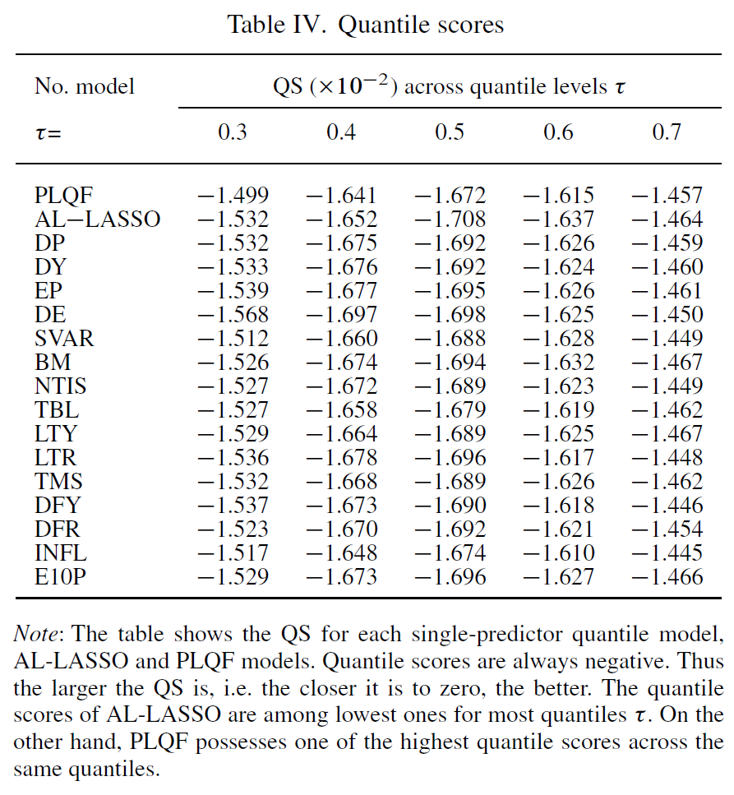

Slide 21
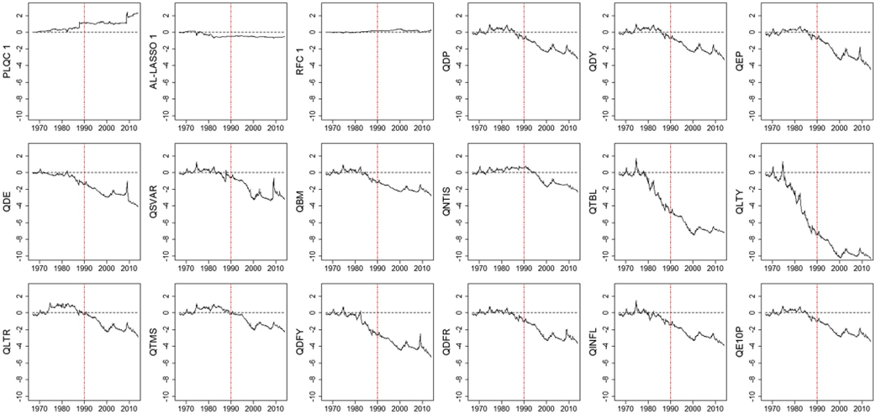
PLQC models are built to handle partially and fully weak predictors across quantiles and over time
Cumulative squared prediction error for the benchmark model minus the cumulative squared prediction errors for the PLQC 1, AL-LASSO 1, RFC 1 and singe-predictor quantile forecasting models, 1967:1–2013:12. A positively sloped curve in each panel indicates that the conditional model outperforms the HA, while the opposite holds for a downward-sloping curve.

Slide 22
Conclusion
Goal: improve equity premium forecasts.
Method: propose a new model post-LASSO quantile forecast(PLQF) to produce more accurate forecasts by minimizing the negative effects of weak predictors and estimation errors.
Result: PLQF forecast outperforms the historical average(HA) and other methods since it can reduce variance and lower bias by integrating LASSO estimation and quantile combination.

Slide 23
Appendix

Slide 24
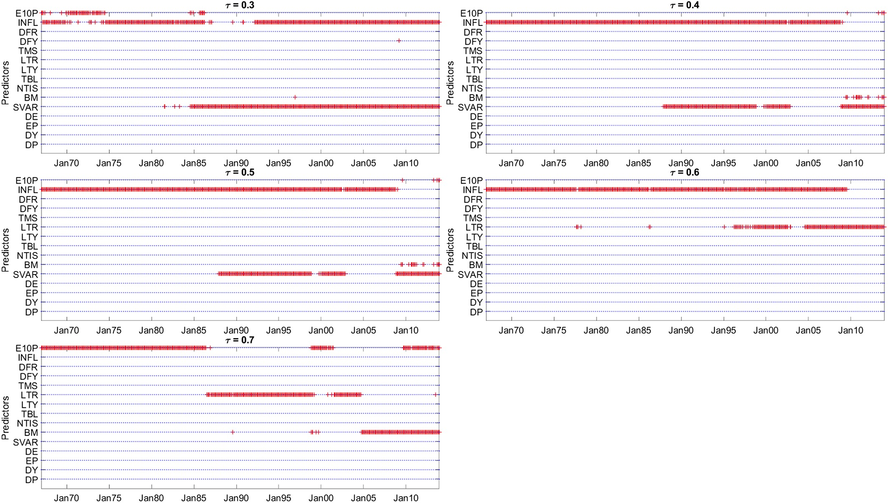
Variables selected for different quantiles over 1963-2013 period

Slide 25
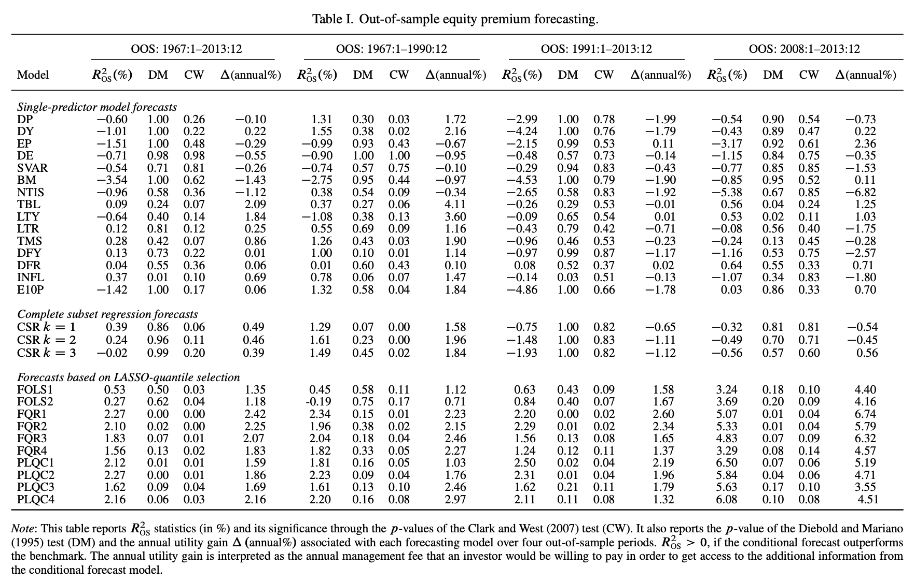
Out of sample premium forecasting

